Slide 1
WELCOME CLASS!!

Slide 2
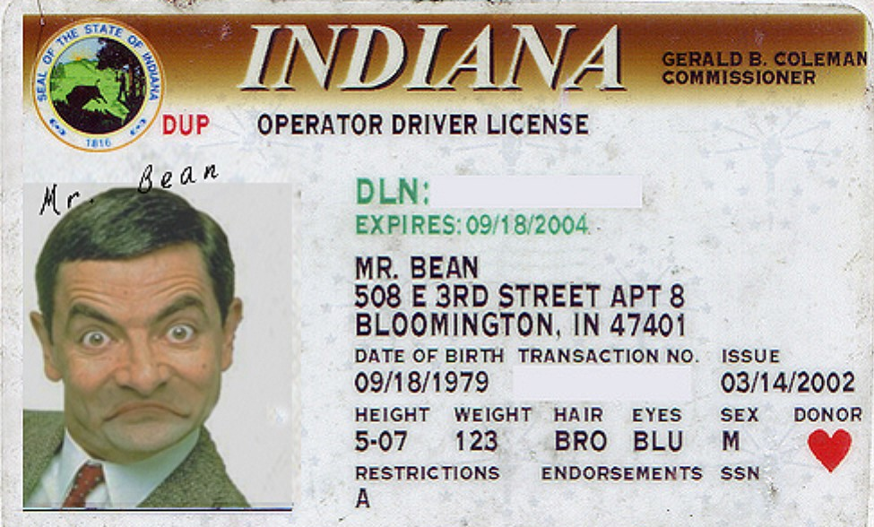

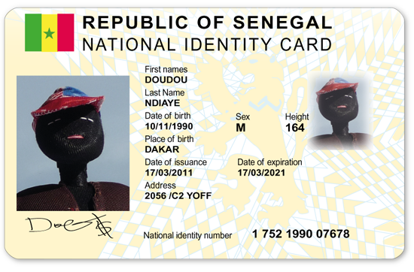
Identification cards!!

Slide 3
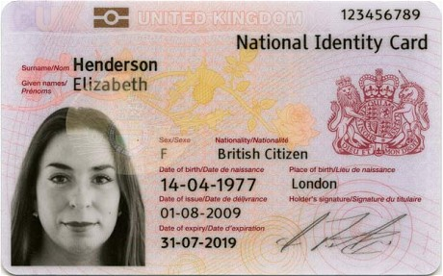
ID card
Last name
Name
Nationality
Where
Is she
from
Picture/photo
Gender
Signature

Slide 4
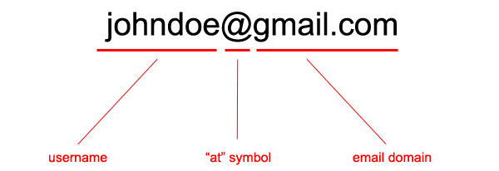
E-mail address
@ = “at”
. = dot
_ = underscore
.com = “dot com”
.pe = “dot p-e”

Slide 5

Gender
MALE
FEMALE

Slide 6
FIRST NAME:
______________________
LAST NAME:
______________________
e-mail address:
______________________
Male: ______________
Female: ___________
STUDENT ID

Slide 7
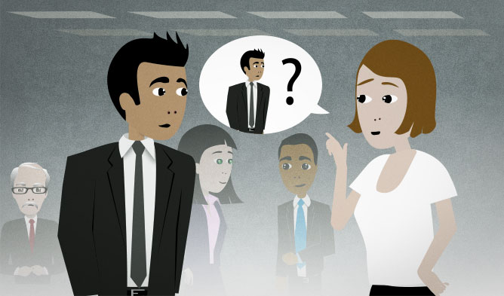
What’s your name?
Alice
My name is _______.

Slide 8
But please, call me _______
Liz
NICKNAMES

Slide 9

SUBJECT
NOUN
PRONOUN
I
Veronica

Slide 10


SUBJECT
PRONOUN
I
YOU

Slide 11



SUBJECT
PRONOUN
HE
SHE
IT

Slide 12


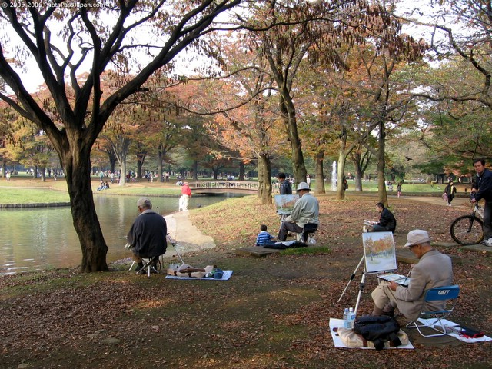
SUBJECT
PRONOUN
WE
YOU
THEY

Slide 13
SUBJECT PRONOUN + VERB TO BE
I
am
I´m
You´re
He´s
She´s
It´s
We´re
You´re
They´re
You
are
He
She
is
It
You
We
are
They

Slide 14

Chris

Slide 15

Nice to meet you /
Please to meet you.
Nice to meet you, too /
Please to meet you, too.

Slide 16


How are you?
Fine. And you?

Slide 17


How are you?
Not bad, thanks.

Slide 18
SUBJECT
NOUN
PRONOUN
I
Veronica

Slide 19
SUBJECT
PRONOUN
I
YOU

Slide 20
SUBJECT
PRONOUN
HE
SHE
IT

Slide 21
SUBJECT
PRONOUN
WE
YOU
THEY

Slide 22
SUBJECT PRONOUN + VERB TO BE
I
am
I´m
You´re
He´s
She´s
It´s
We´re
You´re
They´re
You
are
He
She
is
It
You
We
are
They

Slide 23
Subject pronouns
&
Possessive adjectives

Slide 24

I am a student.
Subject pronoun
My name is Luis
Possessive adjective

Slide 25


You are a student
Subject pronoun
Your phone number is 555-5555
Possessive adjective

Slide 26

She is a girl.
Subject pronoun
Her e-mail address is hello@kitty.com.
Possessive adjective

Slide 27
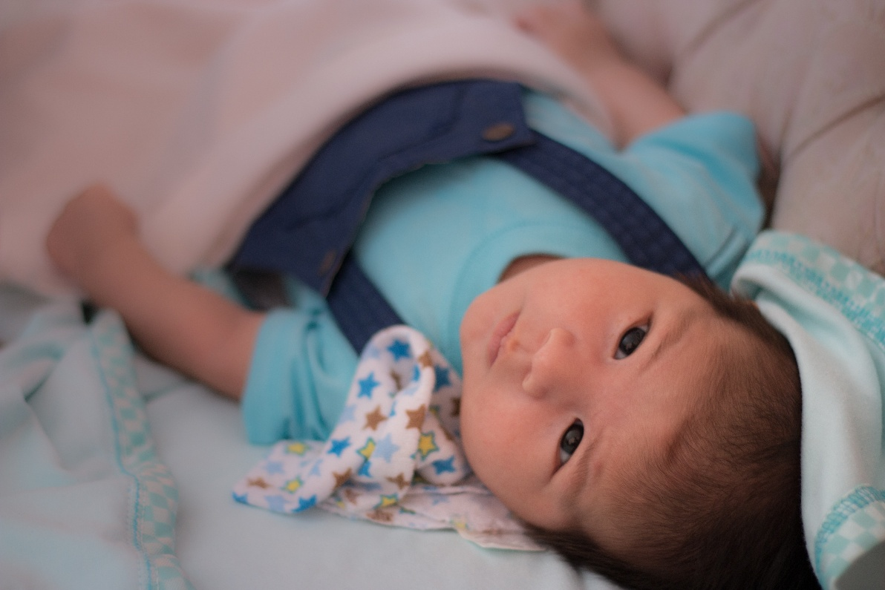
He is my nephew.
Subject pronoun
His name is Stephano.
Possessive adjective

Slide 28

It is a game.
Subject pronoun
Its name is Hangman.
Possessive adjective

Slide 29
HELLO POSSESIVE ADJECTIVES
I
My
He
His
She
Her
It
Its
You
Your

Slide 30
Examples
What’s your name?
I am Pancracito
My name is Pancracito

Slide 31

What’s his e-mail address?
It is timmyt@hotmail.com
His e-mail address is timmyt@hotmail.com

Slide 32
Subject pronouns and Possessive adjectives

Slide 33
I am a student.
Subject pronoun
My name is Luis
Possessive adjective

Slide 34
You are a student
Subject pronoun
Your phone number is 555-5555
Possessive adjective

Slide 35

She is a girl
Subject pronoun
Her e-mail address is hello@gmail.com
Possessive adjective

Slide 36

He is my best friend.
Subject pronoun
His name is Albert.
Possessive adjective

Slide 37

It is a game.
Subject pronoun
Its name is Chess.
Possessive adjective

Slide 38
Possessive exercises
Basic 1 Unit 1 a

Slide 39
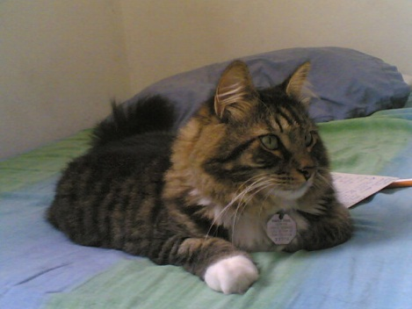
My / I´m pen is red.
His / He´s name is Jorge
Lucia is her / she´s friend.
Her / she´s favorite TV Show is C.S.I.
Its / it´s a book.
Its / it´s name is Koshka.
Your / you´re name is Kiki.
This is your / you´re textbook.

Slide 40
My / it´s pen is red.
Her / his name is Jorge
Lucia is her / she´s friend.
Her / it´s favorite movie is The Hunger Games.
My / it´s a book.
Its / his name is Koshka.
Your / you´re name is Kiki.
This is your / youre textbook.

Slide 41
Communication

Slide 42
QUESTIONS
What´s your name?
What´s your e-mail address?
What´s your phone number?
My name is Cristina Diaz.
My e-mail address is Cdiaz@eazypost.com
My phone number is (399) 555-7061.

